Slide 1

MATHEMATICAL FUNCTIONS:
The JavaScript math object provides several constants and methods to perform mathematical operations on numbers.
Let's see the list of JavaScript Math methods

Slide 2
<html>
<head> <title> Mathematical Functions </title></head>
<body>
<h1 align=center><u> Mathematical Functions </u></h1>
<script language="JavaScript">
var a = Math.abs(-1);
document.writeln(a);
</script>
</bdoy>
</html>

Slide 3

<html>
<head> <title> Mathematical Functions </title></head>
<body>
<h1 align=center><u> Mathematical Functions </u></h1>
<script language="JavaScript">
var a = Math.max(10,20,50,60,100);
document.writeln(a);
</script>
</bdoy>
</html>

Slide 4

<html>
<head> <title> Mathematical Functions </title></head>
<body>
<h1 align=center><u> Mathematical Functions </u></h1>
<script language="JavaScript">
var a = Math.min(10,20,50,60,100);
document.writeln(a);
</script>
</bdoy>
</html>

Slide 5
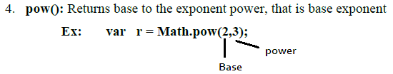
<html>
<head> <title> Mathematical Functions </title></head>
<body>
<h1 align=center><u> Mathematical Functions </u></h1>
<script language="JavaScript">
var a = Math.pow(2,4);
document.writeln(a);
</script>
</bdoy>
</html>

Slide 6

<html>
<head> <title> Mathematical Functions </title></head>
<body>
<h1 align=center><u> Mathematical Functions </u></h1>
<script language="JavaScript">
var a = Math.round(2.4);
document.writeln(a);
</script>
</bdoy>
</html>

Slide 7

<html>
<head> <title> Mathematical Functions </title></head>
<body>
<h1 align=center><u> Mathematical Functions </u></h1>
<script language="JavaScript">
var a = Math.sqrt(16);
document.writeln(a);
</script>
</bdoy>
</html>

Slide 8

<html>
<head> <title> Mathematical Functions </title></head>
<body>
<h1 align=center><u> Mathematical Functions </u></h1>
<script language="JavaScript">
var a = Math.ceil(25.689);
document.writeln(a);
</script>
</bdoy>
</html>

Slide 9

<html>
<head> <title> Mathematical Functions </title></head>
<body>
<h1 align=center><u> Mathematical Functions </u></h1>
<script language="JavaScript">
var a = Math.floor(25.689);
document.writeln(a);
</script>
</bdoy>
</html>

Slide 10

<html>
<head> <title> Mathematical Functions </title></head>
<body>
<h1 align=center><u> Mathematical Functions </u></h1>
<script language="JavaScript">
var a = Math.PI;
document.writeln(a);
</script>
</bdoy>
</html>

Slide 11

<html>
<head> <title> Mathematical Functions </title></head>
<body>
<h1 align=center><u> Mathematical Functions </u></h1>
<script language="JavaScript">
var a = Math.random();
document.writeln(a);
</script>
</bdoy>
</html>

Slide 12
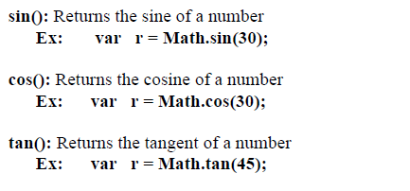

Slide 13
<html>
<head> <title> Mathematical Functions </title></head>
<body>
<h1 align=center><u> Mathematical Functions </u></h1>
<script language="JavaScript">
var a = Math.sin(30);
document.writeln(a);
var a = Math.cos(30);
document.writeln("<br>", a);
var a = Math.tan(45);
document.writeln("<br>", a);
</script>
</bdoy>
</html>

Slide 14
OPERATORS In Java Script
Java script language supports following operators
1. Arithmetic Operators
2. Relational (comparison) operators
3. Logical operators
4. Assignment operators
5. Conditional operators
6. The + operator used on strings

Slide 15
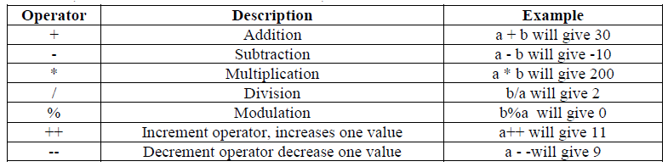
Arithmetic Operator:-
These operators take numerical values as their operands and return a single value. (a, b variables holds a= 10, b=20 then)

Slide 16
<html>
<head> <title> Mathematical Functions </title></head>
<body>
<h1 align=center><u> Mathematical Functions </u></h1>
<script language="JavaScript">
var a = parseInt(window.prompt(" Enter a value "));
var b = parseInt(window.prompt(" Enter b value "));
document.writeln("a value is:",a);
document.writeln("<br> b value is:", b);
document.writeln("<br>", a+b);
document.writeln("<br>", a-b);
document.writeln("<br>", a*b);
document.writeln("<br>", a/b);
document.writeln("<br>", a%b);
document.writeln("<br>", ++a);
document.writeln("<br>", --a);
</script>
</bdoy>
</html>

